Slide 1
Big Energy Saving Network

Slide 2
What we will cover
Warm Homes Discount
The Priority Service Register
Energy Efficiency Grants
How to switch to find the best deal on your gas/electricity
What do if you are in debt with your energy supplier
Support Agencies

Slide 3
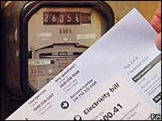
Warm Home Discount Scheme
You might be able to get £140 off your electricity bill under the Warm Home Discount Scheme if you’re either:
getting the guarantee credit part of Pension Credit
on a low income
Check with your supplier to see if they offer the Warm Home Discount.
Notes:
Show video
Facilitator notes
Key points to cover:
Some electricity suppliers offer a discount of £140 off your energy bill if you are eligible.
The money is not paid to you - it is a one-off discount on your electricity bill between September and March.
You may be able to get the discount on your gas bill instead if your supplier provides you with both gas and electricity. Contact your supplier to find out.
You can still get the discount if you have a pre-pay or pay as you go meter. If you’re eligible your supplier can tell you how you’ll get the discount, for example as a voucher you can use to top up your meter.
If you currently get the discount and are thinking of switching supplier, check that the new supplier offers the discount. If it does not, you may find the offer is not such a good deal.
Note: If you're considering a switch and receive WHD to check that the new supplier offers the discount as not all do.
Utilita stopped

Slide 4
Priority Services Register
Offers extra services free of charge if you:
are of pensionable age
are disabled or chronically sick
have a long-term medical condition
have a hearing or visual impairment or additional communication needs
are in a vulnerable situation
To be added to the Priority Services Register, you simply need to contact your energy supplier. You can find their contact details on your energy bill.
Notes:
Facilitator notes
Explain that each energy network offers different support and that you should call your energy network before you apply to join the Priority Services Register to check exactly which services you could get.
Example services include:
Improved access to your meter
Password protection scheme - to help you confirm staff are genuine when they visit your home
Bill nominee scheme - arranging for bills to be sent to the address of a friend, relative or carer
Advance notice and support during power cuts and interruptions
Services for customers with impaired hearing or vision
Free gas appliance safety check

Slide 5
Energy Efficiency Grants (Local Authority)
Lincs 4 Warmer Homes
Lincs 4 Warmer Homes is Greater Lincolnshire’s new partnership scheme between local authorities across the region, offering energy efficiency improvements and advice
2 Schemes :
Warm homes Fund
Energy Company obligation
https://www.nelincs.gov.uk/homes-and-property/lincs-4-warmer-homes/
Tel: 01472 326434 ( mon- Fri 9.00am-4.00pm)
Notes:
Warm homes Fund
provides home energy solutions to owner occupied households living in fuel poverty, where mains gas is not their primary source of heating.
Improvements available as part of this funding include:
A-rated gas central heating, or LPG alternative where main gas is not an option
Connection to the mains gas network, if required
If you are in receipt of certain income related benefits and current rely on inefficient storage heaters, fixed and or portable room heaters or solid fuel fires could be eligible for this funding, subject to survey to determine eligibility and acceptance by the installer. Funding is limited and will be release on a first come first served basis.
Energy Company Obligation
The Energy Company Obligation (ECO) funding stream is led by Government and directs large energy companies to help households reduce their energy bills and associated carbon emissions, by funding the scheme for residents meeting select criteria.
Improvements available as part of this funding include:
Loft insulation
Cavity wall insulation
Solid wall insulation
Boiler replacements
First time central heating

Slide 6
Energy Efficiency Grants
Green Homes Grant
Homeowners and landlords in England can apply for a voucher towards the cost of installing energy efficient and low-carbon heating improvements to homes, which could help save up to £600 a year on energy bills
Vouchers up to £5000 - must be used to install at least one primary home insulation or low carbon heating measure
https://www.gov.uk/guidance/apply-for-the-green-homes-grant-scheme
https://www.simpleenergyadvice.org.uk/pages/green-homes-grant
T: 0800 444 202
Notes:
SHOW VIDEO RE ENERGY EFFICIENCY
The maximum value of the voucher is £5,000. You may be able to receive a higher level of subsidy if you are a homeowner and either you or a member of your household receives one of the qualifying benefits, covering 100% of the cost of the improvements. The maximum value of these voucher is £10,000. Landlords cannot apply for the low-income part of the scheme.

Slide 7
Home Energy Checks and Equipment from Age UK Lindsey
Over 65 you may qualify
Energy efficiency check currently over the phone and can provide for example:
Insulation foam for doors and windows
Letter box seals
External door brush seals
Radflek and Novotherm radiator panels
For a limited period - E-ON’s boiler replacement scheme ( East/ West Lindsey) 01507 524242 ext. 2037.
Lincoln :0345 5564 144 (option 6)
Notes:
which is aimed at assisting those with an existing central heating system where their boiler is broken and beyond economical repair. The householder must be on one of these benefits:
✓ Guarantee element of Pension Credit OR
✓ Income-related Employment and Support Allowance (ESA) OR
✓ Carer’s Allowance
This limited offer is only available to householders that own their own properties. And for a small customer contribution (£395) they can have installed a new boiler usually within 6 weeks from the initial inquiry. For this exciting offer please call Age UK Lindsey on 01507 524524 ext. 2037.
Lincoln number:0345 5564 144 (option 6)
Remember to mention Anglian water stuff too.

Slide 8
Shopping around can reduce your energy costs
You have a choice in who you buy your gas and electricity from.
You can save lots of money by shopping around. You may save money by:
moving to a cheaper deal / tariff with your current supplier
switching to a new supplier
changing your payment method
Notes:
Facilitator notes
Consumers have a choice in who they buy their gas and electricity from.
Shopping around for the best deal can make paying for energy much cheaper.
Those who have not changed supplier for several years are likely to save the most by switching.
Explain that a tariff is the amount you pay for your energy and that it can vary according to how you pay. Many energy companies offer tariffs for online, fixed, capped, single and dual fuel.
Explain that if you rent your home you can usually still switch supplier.
You have the right to switch supplier if you pay for your gas and electricity directly
If your landlord pays your supplier and then charges you, you don’t have the right to switch supplier.

Slide 9
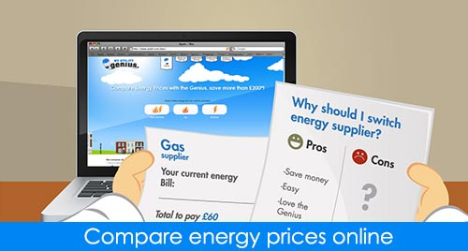
Before you decide to switch
You should start by:
checking which type of meter you are on
finding out if your contract with your supplier has an ‘exit fee’ for leaving early - it’s usually on your bill
looking at the tariffs offered by your current supplier
Notes:
Facilitator notes
Explain that if you have a prepayment meter you’ll usually be restricted to ‘prepayment tariffs’. There are fewer of these to choose from and will be more expensive than direct debit tariffs.
Explain that if you have a contract with a current supplier for a set period of time you may have to pay an ‘exit fee’ if you wish to leave the contract early. This can usually be found on an energy bill and the Citizens Advice ‘Understanding your energy bill’ tool can help you find this information

Slide 10
Finding the best deal
Use the Citizens Advice price comparison website: https://energycompare.citizensadvice.org.uk/
You’ll need:
the name of your supplier and current tariffs
how much energy you used in the past year
how you currently pay for your energy (for example, prepayment meter or direct debit)
your postcode
Notes:
Facilitator notes
Show where users can find the Citizens Advice price comparison tool and demonstrate how it can be used to compare energy tariffs. Encourage users to also look at the Citizens Advice star rating system which compares suppliers’ performance on such issues as customer service and treatment of vulnerable consumers.
Explain that they will need the information detailed on the slide to use the tool. Note, the tool can be used without knowing how much energy you have used in the past year - but providing this information will give a more accurate quote.
You could also demonstrate how the Citizens Advice understanding your energy bill tool can be used to find this information.
Show you tube video

Slide 11
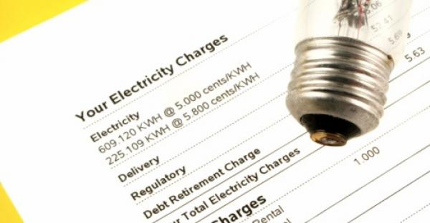
Finding the best deal
Other ways to compare tariffs from different suppliers
Use an Ofgem accredited price comparison website
Talk to your current energy supplier or look at their website
Contact other energy suppliers to compare deals
Join a Collective Energy Switch Scheme
Notes:
Facilitator notes
Explain that there are ways other than the Citizens Advice price comparison tool that consumers can compare energy deals.
Make it clear that if they wish to use an alternative price comparison site they should choose one that is accredited to the Confidence Code, run by Ofgem the independent regulator.
Explain that they can contact their current supplier to find out about the different tariffs they offer - but note that they will only give information on their own tariffs.

Slide 12
How to switch tariff
If you decide to change tariff you’ll need to contact the supplier to arrange the switch.
This can be done:
through a price comparison website or collective energy switch scheme
by getting in touch with the supplier directly
If you’re moving to a new supplier they will let your existing supplier know.
Notes:
Facilitator notes
Explain that if you decide to stay with your current supplier but wish to change to a different tariff your supplier will arrange the change. You’ll need to contact them to let them know what you want to do. They should then write to you confirming the details of your new contract.
Explain that if you find a new deal and sign up to it through a price comparison website they will contact the supplier who will then arrange the switch.
Explain that if switching to a new supplier not through a price comparison site you need to contact them directly to arrange the switch - the new supplier will notify your existing supplier.
Explain that you have the right to see a contract and if you aren’t sent one automatically you should request it. Check it’s correct and the date that you are set to change supplier. You may have the right to cancel the contract within a 14 day cooling-off period, depending on how and where you agree to the contract.

Slide 13
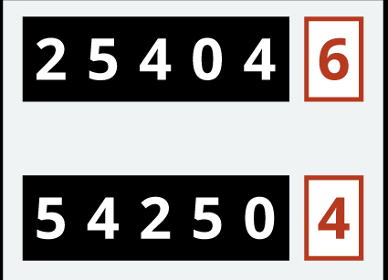
How to switch supplier
Take a meter reading
Take a meter reading on the day of the switch
Give this reading to your new supplier - this means they won’t charge you for energy used before the switch
Notes:
Facilitator notes
Your new supplier will read the meter, or ask you to take a reading, around the time of changing supplier.
Your old supplier will use this reading to work out your final bill and the new supplier will use it to start the new account.
You should keep a note of the reading in case of any future dispute.

Slide 14
Summary- How to switch
New supplier contacted directly or via comparison site
Contract agreed over telephone, online or signed face-to-face
Cooling-off period
New supplier contacts current supplier
Consumer receives bill from current supplier and pays
New supplier confirms start date and requests meter reading

Slide 15
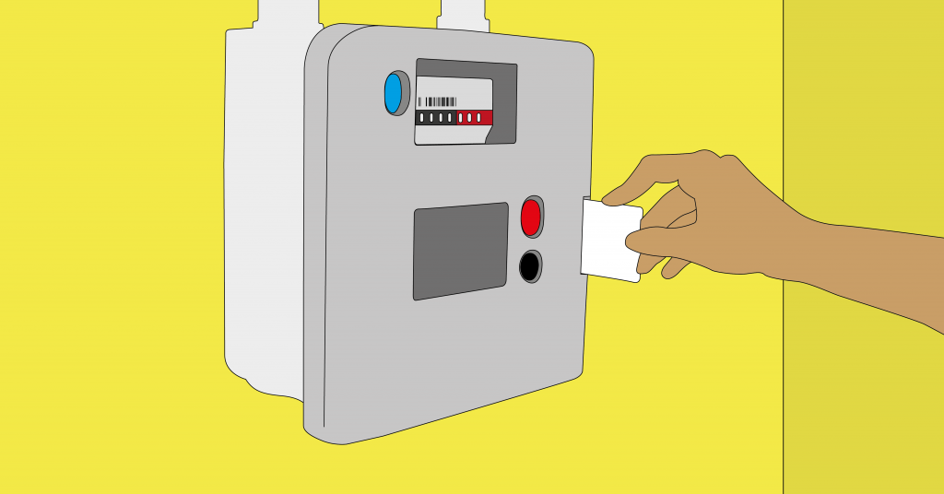
What if I’m in debt to my supplier?
If you use a prepayment meter:
you owe less than £500 for each fuel you can still switch
your debt will transfer with you
If you don’t have a prepayment meter:
your supplier can stop you switching until you’ve paid off your debt
If you are in debt to your supplier speak to them
Access support from debt agencies
Notes:
Facilitator notes
If you are in debt to your current supplier it is possible that they can stop you from switching until you have paid off your debt.
If a client is in debt they should seek further help - contact the Citizens Advice Consumer Service or visit their local Citizens Advice or advice centre
If you have a prepayment meter you can change supplier if you owe less than £500 for each fuel (gas and electricity). Your debt will transfer with you but you may benefit from a lower price which could help you pay it off faster.
If you don’t have a prepayment meter and have an outstanding debt your supplier has the right to prevent you leaving. They can’t stop you leaving if it is their fault you are in debt, for example, if they billed you incorrectly.

Slide 16
Liquid Petroleum Gas (LPG)
The average annual cost for heating and hot water using LPG in the UK is
£796* when consuming around 12,000 kWh of power a year
The price of LPG fluctuates in comparison with heating oil or gas - heating oil was 51p per litre in January 2020, while LPG cost slightly less on average
However if you feel that your LPG costs are high, it’s worth looking for a cheaper supplier. Trade Association Liquid Gas UK has a tool to find LPG suppliers in your area :https://www.liquidgasuk.org/advice/supplier-search
WHICH have useful information on running with LPG and the alternatives to consider as government stops installation of fossil fuel heating systems ( applies to oil)
Notes:
*(Calculated using the average price of LPG across the UK in January 2020; sourced by Sutherland Tables, which collects domestic-fuel pricing data. The cost per kWh in pence (6.64) was multiplied by the kWh a medium gas-energy user consumes on average in a year [12,000 kWh], as calculated by Ofgem.)
The price of LPG has varied by 15p per litre over the past five years. This means that it has sometimes been more expensive than heating oil, and sometimes less expensive.

Slide 17
Heating Oil
The average annual cost is £830* for both heating and hot water using heating oil in the UK, when consuming around 17,000 kWh's worth per year
The price of heating oil can fluctuate, with sudden spikes caused by surges in demand, weather conditions and political unrest
Compare as many quotes as possible from different companies, and do so regularly so you can monitor when and where you can get the best prices
If buying on the internet , look out for sites with premium SSL certificates (the small padlock icon in the top corner of your website bar
Notes:
(Calculated using the average price of kerosene across the UK in January 2020. Note that oil prices tend to be a higher in winter months. Sourced from Sutherland Tables, which collects domestic fuel price data. The cost per kWh in pence (4.88) was multiplied by the kWh a high user consumes on average in a year [17,000 kWh] for hot water and heating, as calculated by Ofgem.)
o matter when you order, it's important to keep an eye on your oil-tank gauge. Don't let it get too low before you order – less than a quarter full, for example – especially in winter. 3 Bulk buy heating oil The size of your tank will affect how much heating oil you can store, and therefore how much you can order in one go. Generally speaking, the more you order, the cheaper it will be. The average size of domestic heating oil tanks ranges between 1,000 and 3,500 litres (although larger ones are used commercially). It’s worth noting that a heating oil tank should only be filled up to around 80-90% of its capacity to avoid spillage. If your tank doesn't have a large capacity, joining a heating oil club (also called a heating oil buying group) free of charge is a good way to buy cheaper heating oil. This is because your order will be clubbed together with others in your area. The Citizens Advice Bureau estimates that buying this way can knock 10% off your heating oil bills. Besides searching online for heating oil clubs in your area, it’s also worth looking at websites that combine regional oil clubs together to increase orders even further, such as The Oil-Club. The UKIFDA has guidance for communities on local oil buying groups.
Read more: https://www.which.co.uk/reviews/heating-oil/article/heating-oil-explained/getting-the-best-heating-oil-prices-ai4JE3I6UmJ1 - Which?

Slide 18
Test Your Learning
1.How many people in the UK have never switched energy provider?
73%,27%, Everyone has
I pay my own energy bill. Can I can switch energy provider even though I'm a renter? Yes , No
I have a smart meter. Can I switch energy supplier? Yes, No
How long do energy companies signed up to the Energy Switch Guarantee have to complete your switch? 1 day, 21 days, 30 days
The government is providing a Green Homes Grant to help 600,000 homeowners make their homes warmer and energy bills cheaper. If you are a homeowner how much could you get under the Green Homes Grant?
£1000, £3,000, £5,000
Notes:
The Energy Switch Guarantee is an industry initiative where energy companies have committed that switching will be simple, speedy and safe.
Correct, suppliers have to switch you within 21 days. It used to be more like four to six weeks! (There’s also a cooling off period, where you can change your mind within 14 days to stay with your current provider). https://www.energyswitchguarantee.com/about-the-energy-switch-guarantee/
Correct! Homeowners in England, including landlords, can get up to £5,000 to pay part of the cost of energy saving measures like insulation. Low income households can get 100% of the costs of work covered up to £10,000. Find out more here: http://tiny.cc/greenhomesgrant

Slide 19
Big Energy Saving Winter
Great Website lots of very useful advice
https://bigenergysavingwinter.org.uk/

Slide 20
Useful Contact Numbers/ Websites
Citizens Advice Consumer Service : 08082231133
https://www.citizensadvice.org.uk/consumer/energy/energy-supply/
Step Change : 0800 138 1111
https://www.stepchange.org/
Winter Fuel Payments Helpline Number
https://www.gov.uk/winter-fuel-payment
Ofgem : Energy Regulator (Complaints) 020 7901 7295
https://www.ofgem.gov.uk/
Why you shouldn’t leave devices on standby mode
https://www.money.co.uk/energy/guides/why-you-should-not-leave-devices-on-standby-mode
Notes:
Evaluation… marketing means

Slide 21
My Contact details
T: 01529 201962
E: janet.clark@lincsymca.org.uk
Website: www.communitylincs.com
Thank you

